Slide 1
Numerical Computation
and
Machine Learning Basics
https://github.com/timestocome/DeepLearning-Talks

Slide 2
Overflow and Underflow
Overflow -+/- infinity, NaN, wrapping
Underflow - numbers fade to zero
vanishing gradients [ clip gradients, add epsilon ]
exploding gradients [ clip gradients, use regularization ]
Pentium FDIV Bug
GPU truncation causing non-linearity
https://blog.openai.com/nonlinear-computation-in-linear-networks/
Most ML libraries will handle NaN, -/+ inf, div by zero for you, or add epsilon ( a very small number ) to denominator
Wrapping: use a 16 bit int to count in a loop and it'll wrap at 65,536 - 1
don't use loops
use a very large loop index

Slide 3
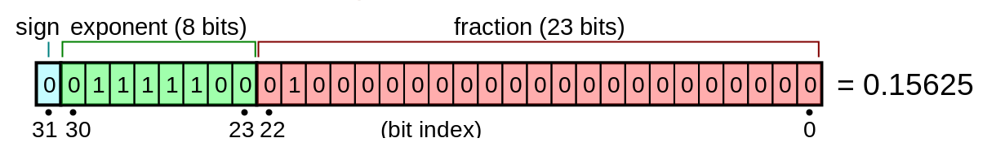
IEEE Standard
(-1 * s) x (fraction) x (2 ^ exponent)
(* fraction is usually named mantissa)
Size of ints, longs, floats, doubles on your computer
https://www.programiz.com/c-programming/examples/sizeof-operator-example
http://cstl-csm.semo.edu/xzhang/Class%20Folder/CS280/Workbook_HTML/FLOATING_tut.htm
http://www.boundedfloatingpoint.com/PressRelease_011718.pdf ( end of floating point errors ? )

Slide 4
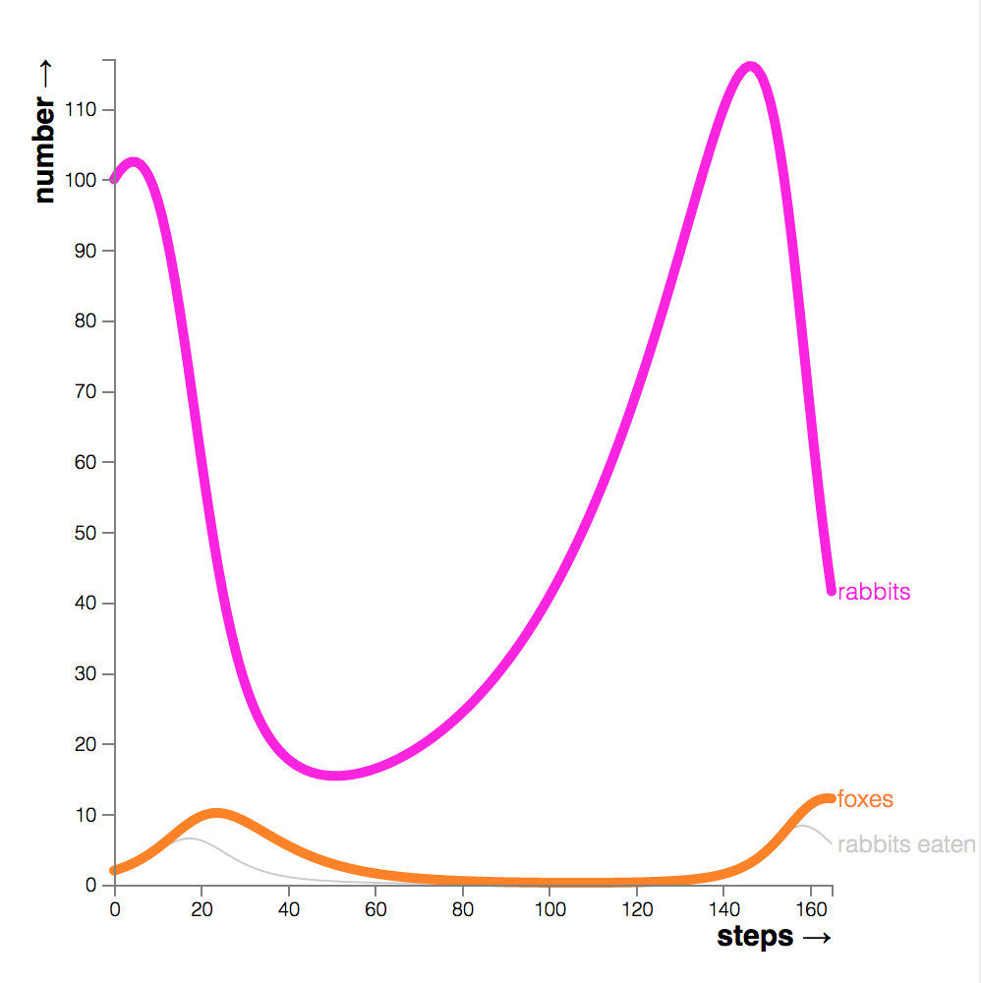
Poor Conditioning
Conditioning is how quickly a function changes
Even a small learning rate increases the error causing the network to become stuck
In a small network this is a local minima, in a deep network it's a saddle point
Fix: use an adaptive learning rate ( Adagrad, AdaDelta, RMSProp, Adam, Momentum …)
Adaptive learning rates are built into Theano, TensorFlow ...

Slide 5
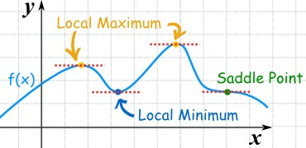
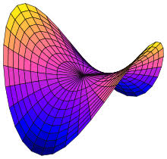
Gradient Based Optimization
Goal is to minimize or maximize a cost function ( loss function, error function)
Using a small learning rate, take a small step in the direction of steepest decrease
Gradient = 0 at minimum, max, saddle point

Slide 6
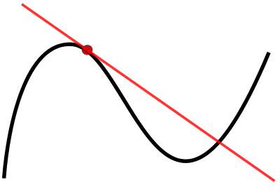
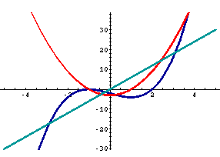
Derivative
Measures the tangent line on a slope which gives you the direction of greatest increase. In neural networks we use the negative of it to get steepest descent.
The 2nd derivative can tell you if you are at a max or min
f" < 0 max
f" == 0 no information
f" > 0 minimum

Slide 7
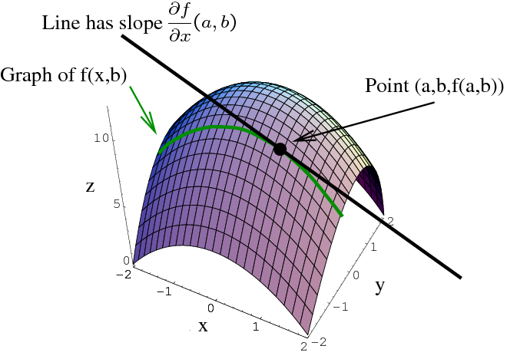
Partial Derivative
Derivatives calculated on vectors ( gradient )

Slide 8
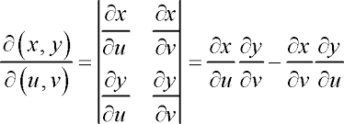
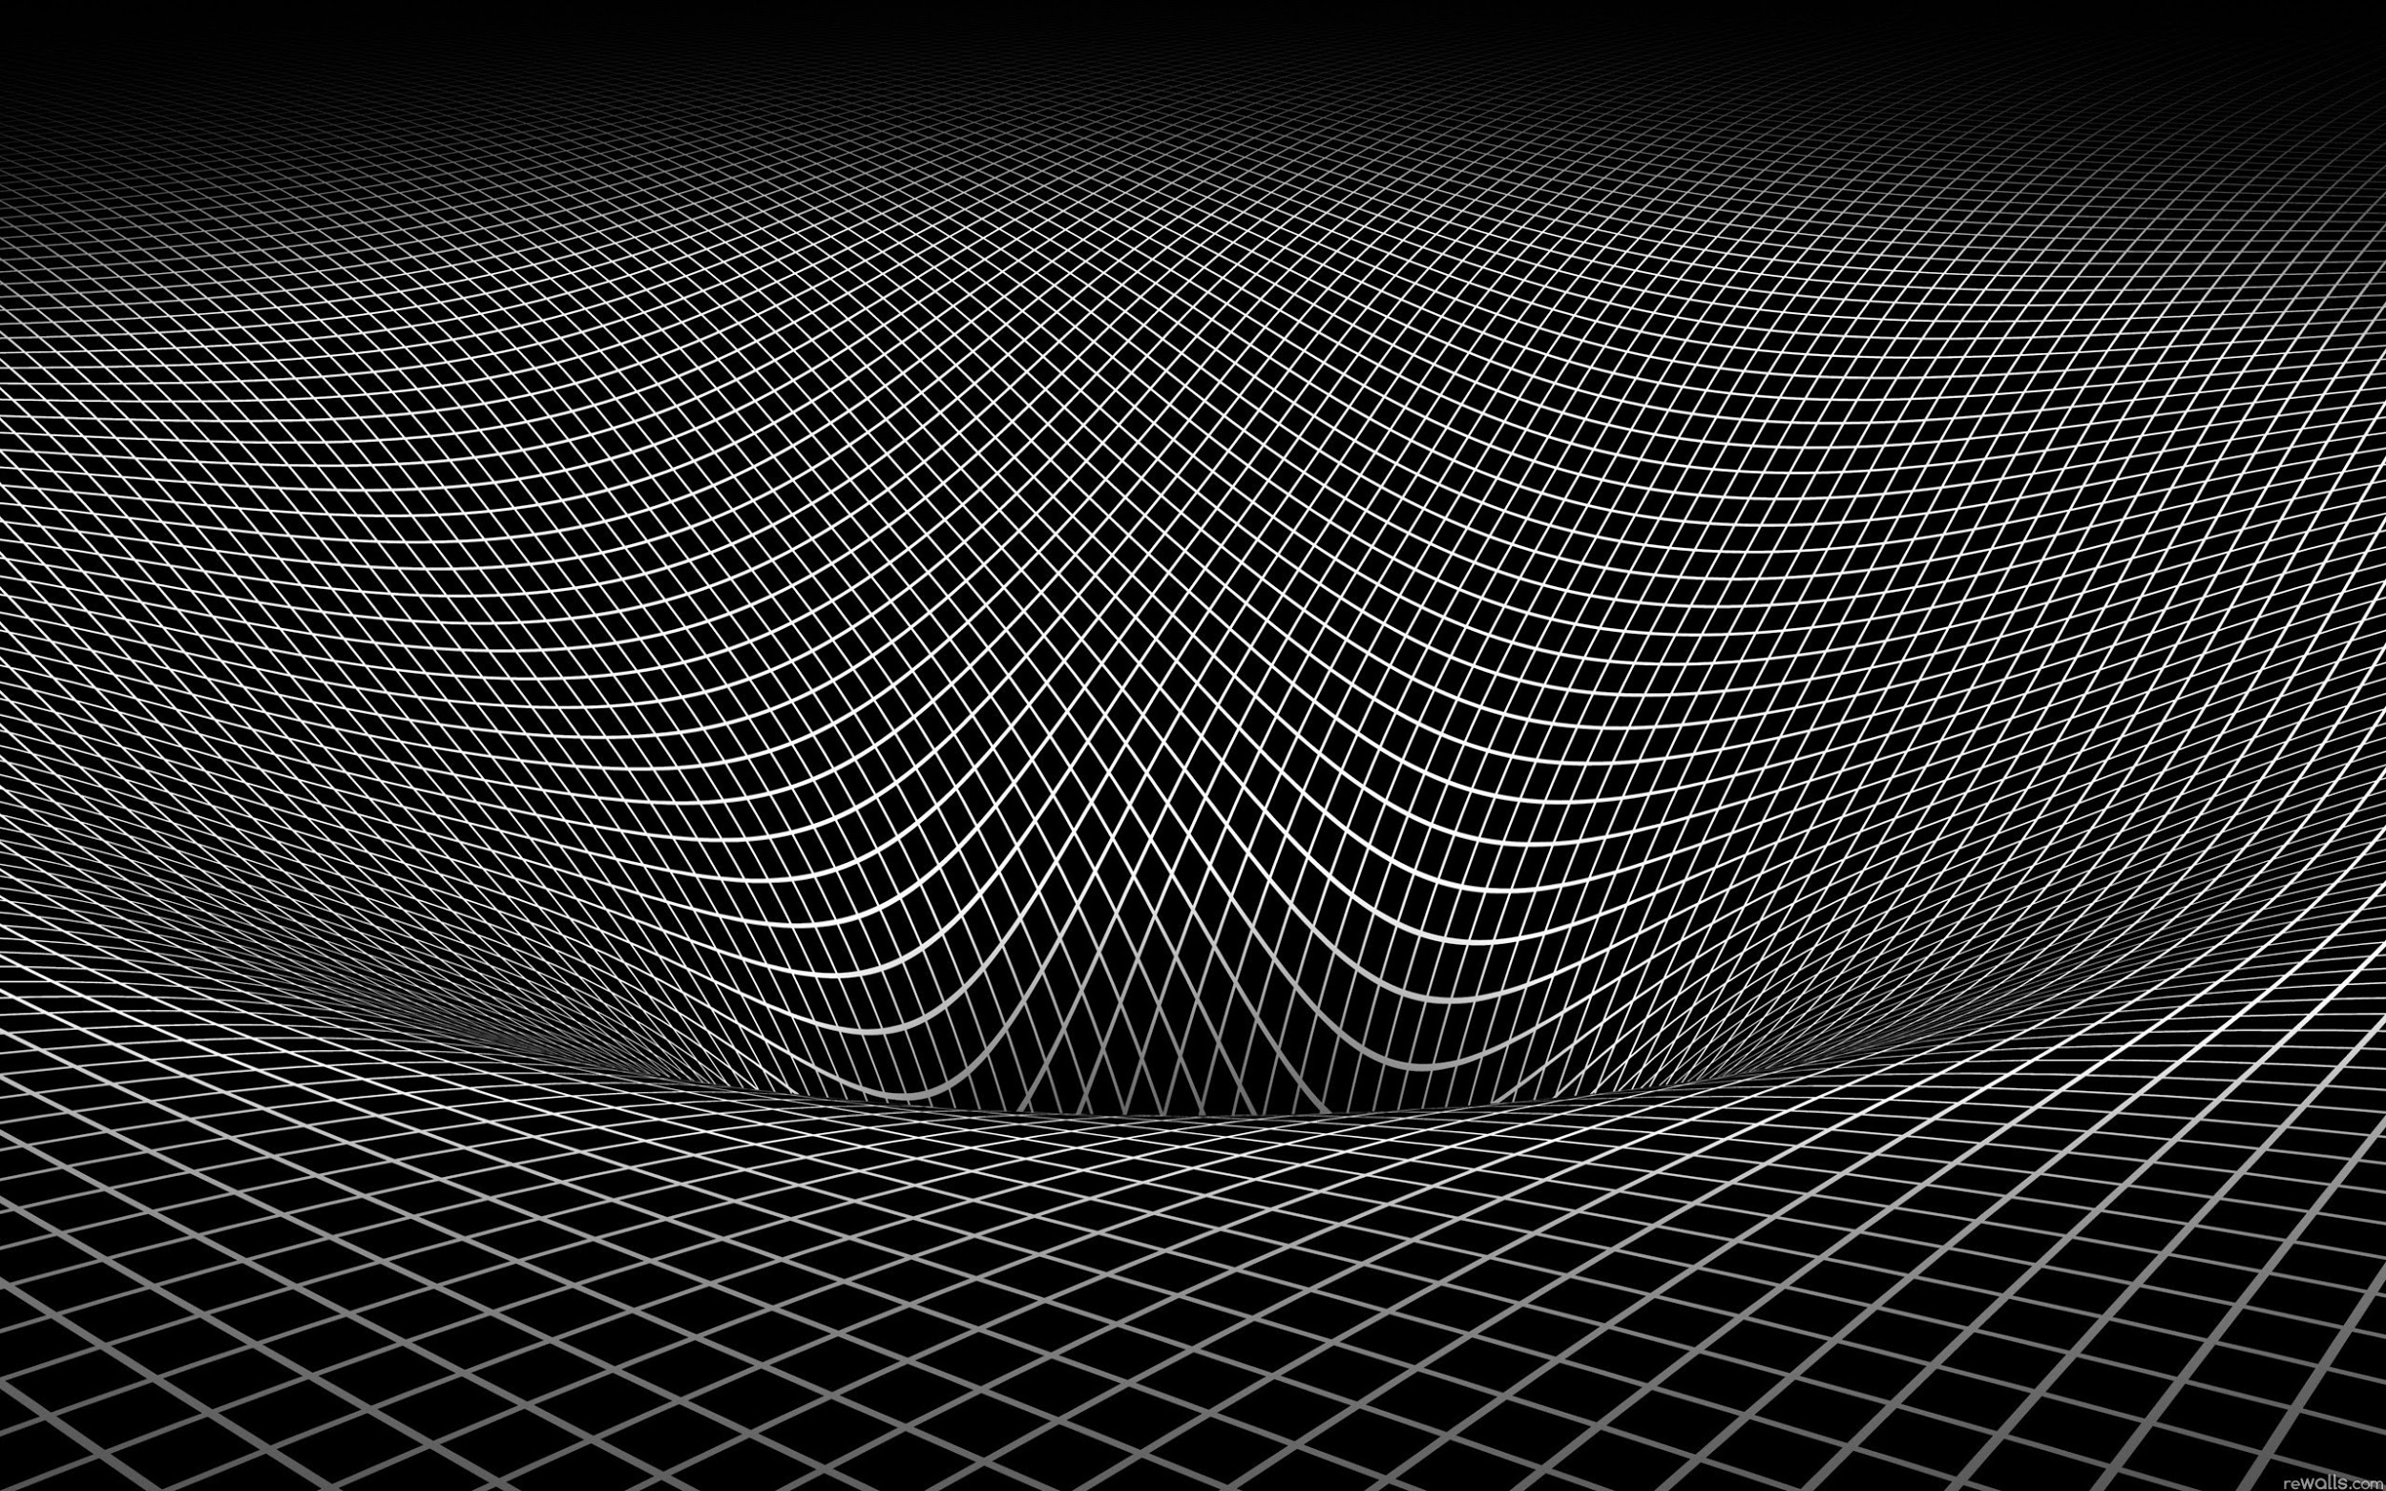
Jacobian Matrix
Take the first derivative of a vector and output a vector to find steepest descent

Slide 9
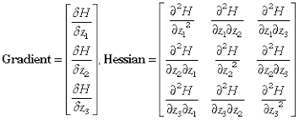
Hessian Matrix
Used to find the 2nd derivative of a vector
Measures the curvature
Use to adjust learning rate (step size)
negative -> maxes negative curvature is down,
positive -> mins curvature is up
zero -> flat space or a saddle point

Slide 10
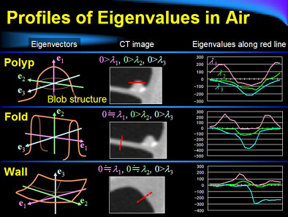
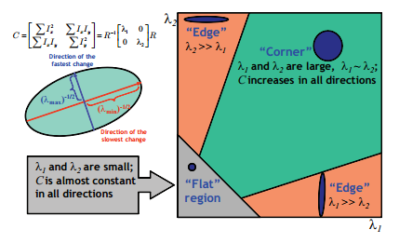
Eigenvalues of Hessian
Find ridges (fingerprints, CAT scans); Motion capture (character animation)

Slide 11
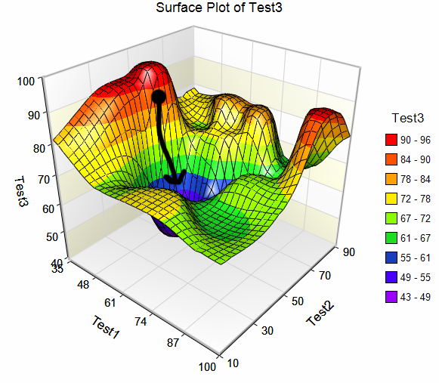
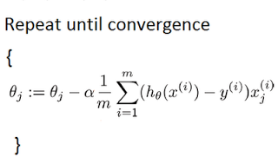
Stochastic Gradient Descent

Slide 12
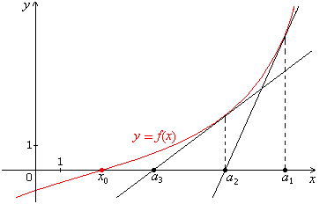
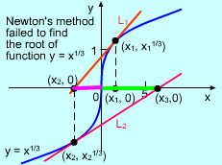
Newton's Method
Approximate f(x) = 0
Keep guessing, split the difference between guesses until f(x) = 0 Usually fails spectacularly, step size missed zero
Code example: http://www.aip.de/groups/soe/local/numres/bookcpdf/c9-4.pdf

Slide 13
Constrained Optimization
More than one cost in the problem
i.e. Find production number that maximizes income using only factory available
Or maximize f(x) subject to g(x)
Often just add g(x) to cost function as a penalty, but a large penalty can create ill conditioned Hessians causing the network to fail to converge

Slide 14
Lagrangian Multiplier
solve: max log(x) + log(y) given: x + y = m
Combine equations, set g(x) to zero max log(x) + log(y) + L(m - x - y)
Set derivatives = 0 1/x - z = 0, 1/y - z = 0, m - x - y = 0
Remove L from x, y 1/x - z = 1/y - z ===> x = y
2 equations, 2 unknowns x = y = m/2
Solve for Lagrangian multiplier z = m/2
http://home.uchicago.edu/~vlima/courses/econ201/pricetext/chapter2.pdf
http://adl.stanford.edu/aa222/Lecture_Notes_files/constrainedOptimization.pdf
https://www.khanacademy.org/math/multivariable-calculus/applications-of-multivariable-derivatives/constrained-optimization/a/lagrange-multipliers-single-constraint

Slide 15
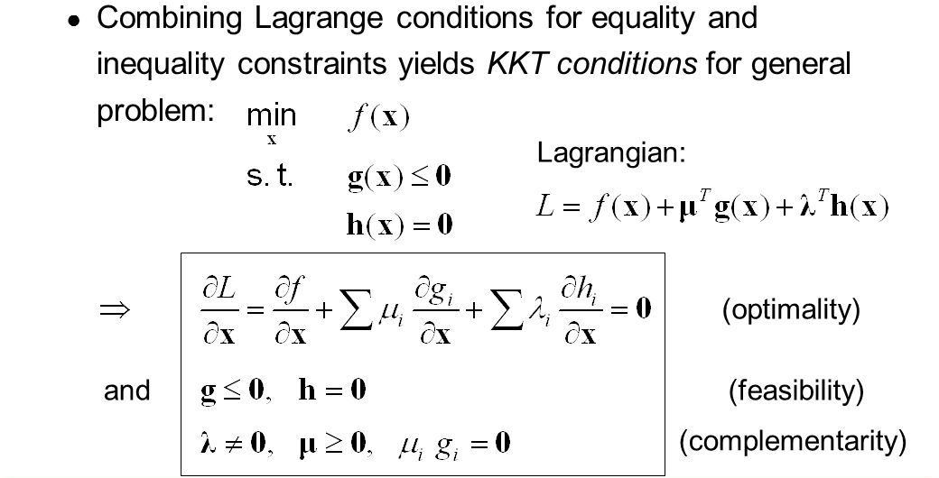
Karush-Kuhn-Tucker Approach
http://slideplayer.com/slide/4991139/

Slide 16
Linear Least Squares with Constraint
Solve: f(x) = ½ ||Ax - b||^2
Constraint: g(x) = x.Tx <= 1
Combine the equations: ½||Ax-b||^2 + z(x.Tx - 1)
set derivative = 0 A.TAx - A.Tb + 2zx = 0
Solve for Lagrangian Multiplier z = (A.TAx - A.Tb) * x/2
and the constraint dL/dz = x.Tx - 1

Slide 17
Learning Algorithms
Able to learn from data
"A computer program is said to learn from experience E with respect to some class of tasks T and performance measure P, if its performance in tasks at tasks in T, as measured by P, improves with experience E."
E: data, sensor input, images,
T: goals
P: error
ML is the field of study that gives computers the ability to learn without being explicitly programmed - Arthur Sammuel

Slide 18
Experience ( data, sensor inputs…)
Missing values
Use most common value, average or median
Interpolation between values ( time series )
Drop that feature
Infer from other features
Categories Use one hot vectors
Sensors Allow for noise

Slide 19
Independent Identically Distributed
Garbage in, garbage out
Independent
- features cannot be correlated
Identically Distributed
training, validation, test data
outputs ( if 90% of the output is true, the network will always guess true and you'll have 90% accuracy - check the confusion matrix )
https://pandas.pydata.org/pandas-docs/stable/generated/pandas.DataFrame.corr.html
http://scikit-learn.org/stable/modules/generated/sklearn.metrics.confusion_matrix.html

Slide 20
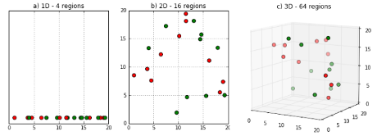
Curse of dimensionality

Slide 21
The Task (Goals)
This is what you want your neural network to solve, the goal
Think carefully, you can get very different answers depending on how you frame your task.
-- First self driving cars were trained with human drivers and learned to drive on their own.
-- Test car is successfully driven down the road, then down a hill into a lake

Slide 22
The Performance Measure ( Cost function)
~ 80% of data is used for training
~ 10% of data to validate
~ 10% of data is held out to be used as a test after training is done
While accuracy less than ( pick a number )%:
shuffle data
run training data in batches
run validation every 100th epoch or so:
Then test on hold out data after training is complete (* never let subcontractors, contest entrants see hold out data )
Training, testing, validation data must be statistically similar
Notes:
--- see if can find training to test data paper ---

Slide 23
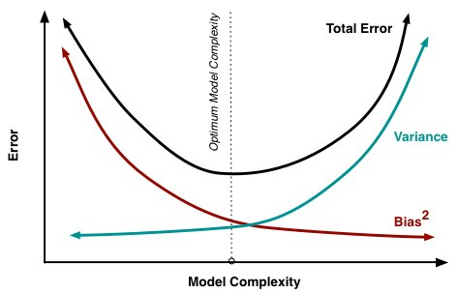
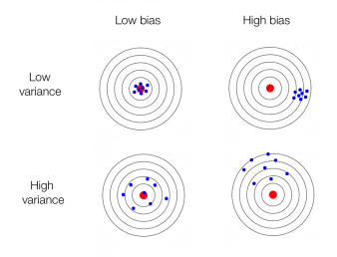
Bias vs Variance
High bias == underfitting High variance == overfitting
MSE = (target - predicted)^2 = Bias^2 + Variance + noise

Slide 24
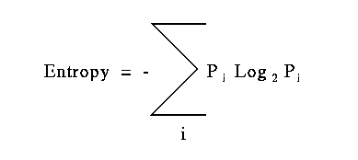
Entropy
Entropy = how many bits are needed to encode information ( * information theory uses Log2, not e, not 10 )
Coin toss: 2 possibilities (heads, tails) == 1 bit
Entropy = - Sum( (½) * log(½) + (½) * log(½) )
Entropy = - ( ½ * -1) + (½ * -1) = -(-½ - ½) = 1
Coin toss: 2 possibilities (heads ⅓, tails ⅔)
Entropy = -(⅓ * log(⅓) + ⅔ * log(⅔) ) = 0.89
A Mathematical Theory of Communication, Shannon
http://affect-reason-utility.com/1301/4/shannon1948.pdf

Slide 25
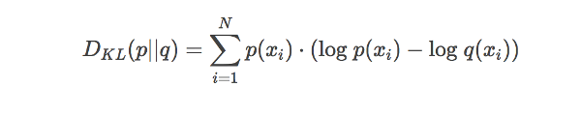
KL Divergence
Kullback-Leibler Divergence tells how much information is lost between the neural network prediction and the actual values
p is probability distribution (actual), q is approximation (predicted)
The principle of maximum likelihood says that given the training data, we should use as our model the distribution f(w) that gives the greatest possible probability to the training data
not a distance measure !
https://www.countbayesie.com/blog/2017/5/9/kullback-leibler-divergence-explained
http://cseweb.ucsd.edu/~elkan/250B/logreg.pdf

Slide 26
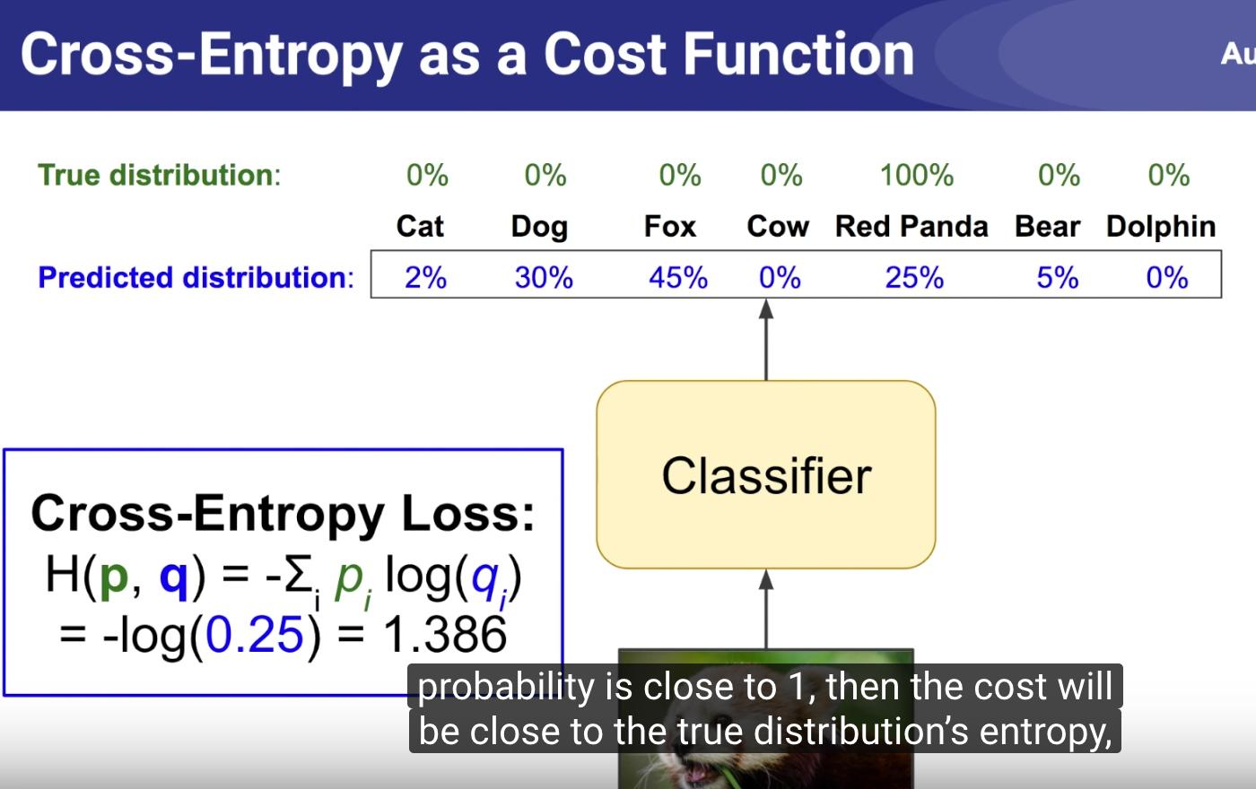
Cross entropy as cost function
Cross entropy = entropy + KL Divergence
entropy = minimum bits needed to transmit actual information
KL Divergence = difference between predicted and actual information
https://www.youtube.com/watch?v=ErfnhcEV1O8&feature=youtu.be

Slide 27
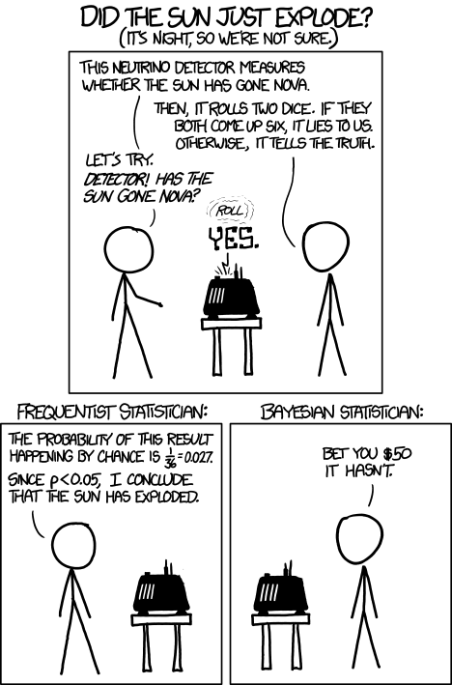
Bayesian vs Frequentist
Bayesian Frequentist
Prior beliefs Repeatable random sample
Fixed parameters Fixed data
mu = mx + b y = mx + b
y = N(mu, std)
N - normal distribution
std - standard deviation
mu - mean

Slide 28
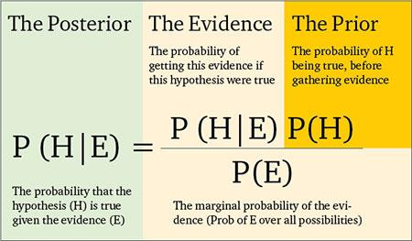
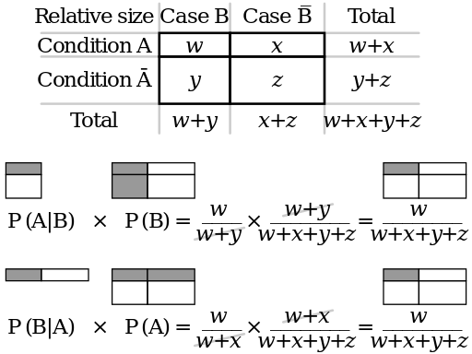
Bayesian Statistics
Intuitive understanding of Bayes
https://arbital.com/p/bayes_frequency_diagram/?l=55z&pathId=28771
http://scikit-learn.org/stable/modules/naive_bayes.html

Slide 29
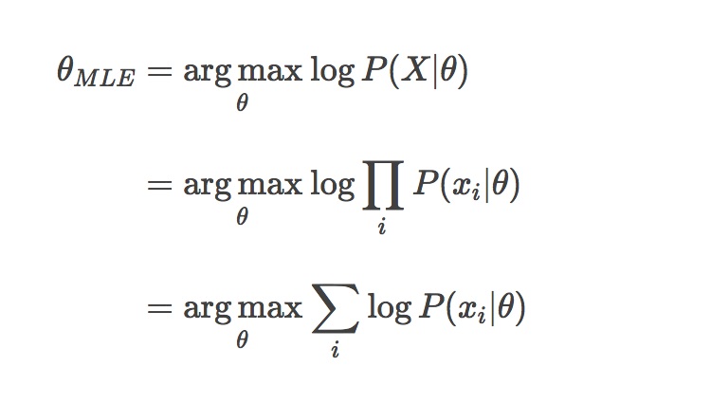
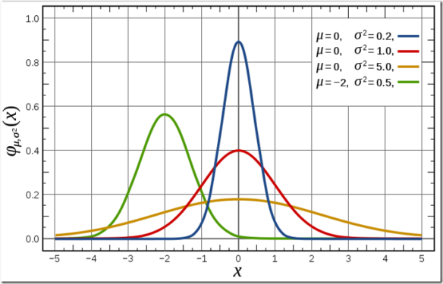
Maximum Log Likelihood (frequentist)
probability of observing the given data as a function of theta

Slide 30
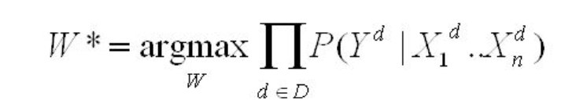
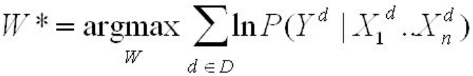
Conditional Log Likelihood ( Bayesian version )
Weights are trained to maximize the conditional data likelihood
which is the same as maximizing the conditional log likelihood
http://cseweb.ucsd.edu/~elkan/250B/logreg.pdf

Slide 31
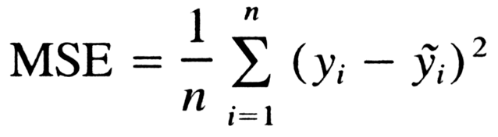
Mean Squared Error
If the data examples are i.i.d.
independent and identically distributed, then the Conditional Log Likelihood can be reduced to the Mean Squared Error

Slide 32
Linear Regression as Maximum Likelihood
Dot product as a measure of similarity between vectors
MSE ~ Conditional log likelihood
As n_samples -> infinity convergence increases
True distribution of data must be in model family
True distribution must correspond to one set of weights
Let's take the Con out of Econometrics
http://www.econ.ucla.edu/workingpapers/wp239.pdf

Slide 33
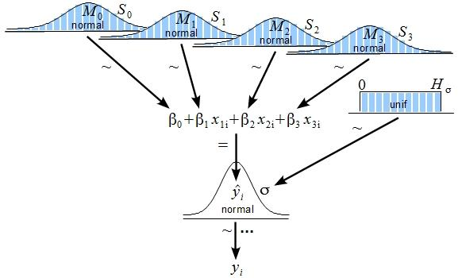
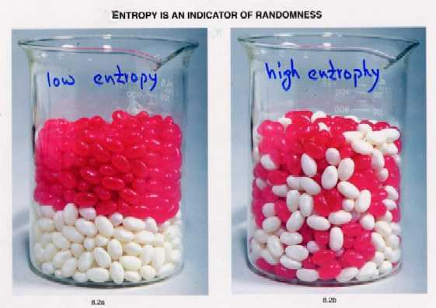
Bayesian Linear Regression
Prior is uniform or Gaussian distribution with high entropy
Observation reduces entropy and drives weights to single values
Using a known prior probability
Prior distribution shifts weights toward simpler smoother curves
https://stats.stackexchange.com/questions/252577/bayes-regression-how-is-it-done-in-comparison-to-standard-regression

Slide 34
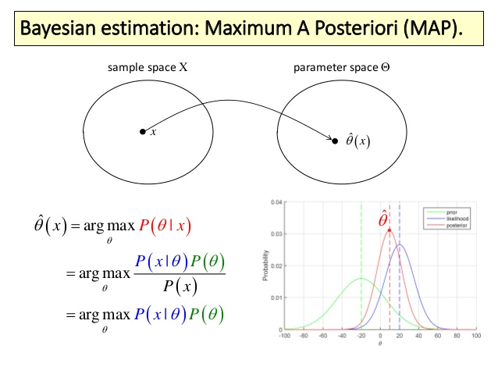
Maximum a Posteriori (MAP) Estimation

Slide 35
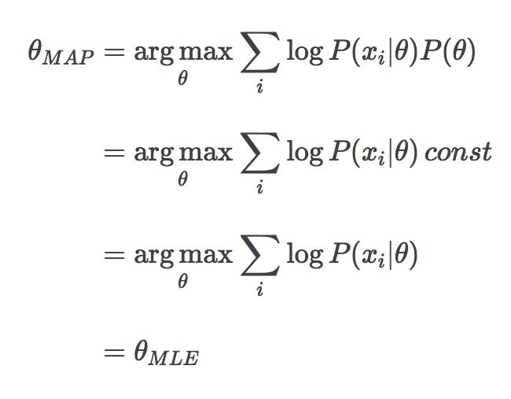
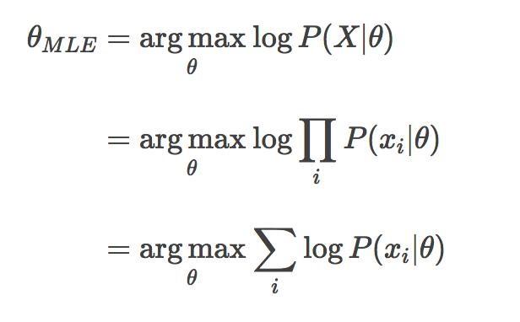
MLE vs MAP
Both compute a single value, not a distribution
MLE - fit a Gaussian to the data
MAP - uses posterior distribution
MLE is a specific case of MAP
https://wiseodd.github.io/techblog/2017/01/01/mle-vs-map/

Slide 36
Cross validation
Split the dataset into 3 sections:
Train on one section
Test on one section
Validate on one section
Shuffle data, split and repeat
Average error gives you an approximate idea of how well an algorithm will perform
Especially useful on small datasets.
http://scikit-learn.org/stable/modules/cross_validation.html

Slide 37
Hyperparameters
Variables used to control the algorithm
max, min, depth of branches on a decision tree
number of layers, size of layers in network
learning rate, complexity constant
Usually a grid search ( nested loops over several options ) is used with cross validation
http://scikit-learn.org/stable/modules/grid_search.html
A recent development is that randomly picking values for a grid search is more effective than stepping through all values.
http://www.jmlr.org/papers/volume13/bergstra12a/bergstra12a.pdf

Slide 38
Regularization
Training adjusts the weights to minimize the error, regularization forces the weights to stay small which forces the network to generalize
Used to prevent overfitting: To be useful a network must be able to generalize to new data.
L1 regularization
L2 regularization
Early stopping
Drop out
Batch normalization

Slide 39
L1 Regularization
aka Lasso
Minimize the sum of the absolute differences
Drives some weights to zero which has the effect of pruning features which acts as a feature selector. Almost never used in real problems because it is not rotationally invariant
L1 = complexity_parameter * sum(abs(W))

Slide 40
L2 Regularization
aka Ridge regression
Limits weight size without driving any to zero, minimizes variance, increases bias
Rotational invariance is the main reason it is used instead of L1
L2 = complexity_constant * sum(W)^2
L1 and L2 have the effect of choosing a different prior in Bayesian solutions
Elastic net uses both L1 and L2 https://web.stanford.edu/~hastie/Papers/B67.2%20(2005)%20301-320%20Zou%20&%20Hastie.pdf

Slide 41
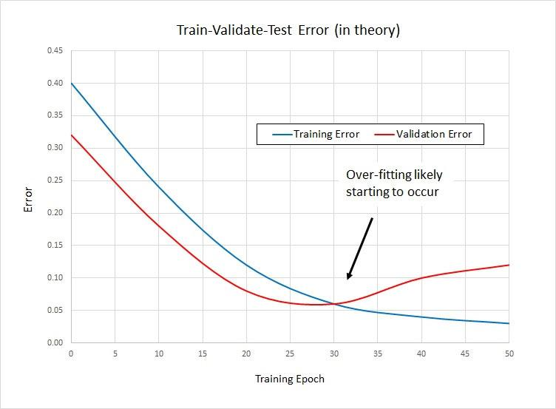
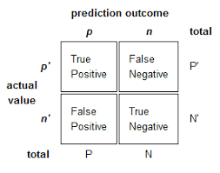
Capacity, Overfitting, Underfitting
Early stopping

Slide 42
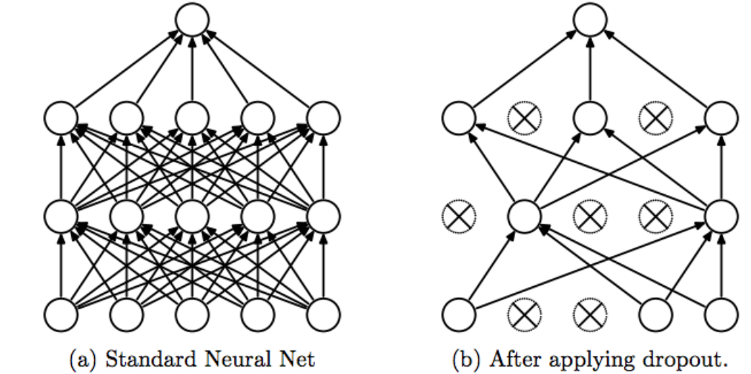
Dropout
Averages predictions over all weights
Randomly exclude a percent of hidden nodes from the neural network, change and randomly exclude a different group on next batch during training.
How to:
Create a matrix the size of the weights matrix
Randomly fill with ones and zeros
Multiply weights by the matrix
Dropout: A Simple Way to Prevent NN from Overfitting
https://www.cs.toronto.edu/~hinton/absps/JMLRdropout.pdf

Slide 43
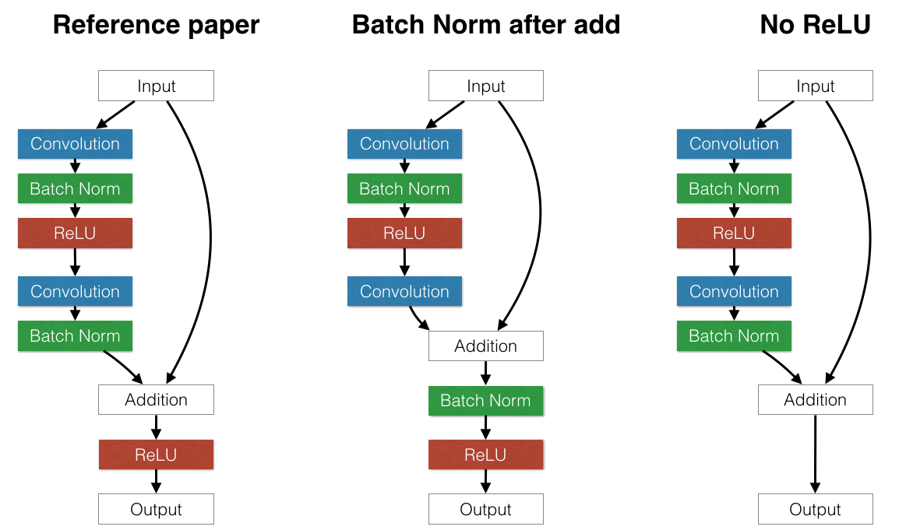
Batch Normalization
Is often used in place of DropOut, can use higher learning rates, networks train faster.
For each batch of training examples recenter the features.
In practice, the original input is fed to later layers
https://arxiv.org/pdf/1502.03167.pdf

Slide 44
Probabilistic Supervised Learning
Normal ( Gaussian Distribution )
Probability of y given x
The activation functions are used to create non-linearity
sigmoid, oldest, may cause vanishing gradients
tanh, steeper than sigmoid, still can cause vanishing gradients
relu, not linear, combinations or Relu also nonlinear, can approximate any function, drives some weights to zero
fast to compute
leaky relu ( use when relu drives all your weights to zero )
softmax ( used in last layer to scale values so they sum up to 1 )

Slide 45
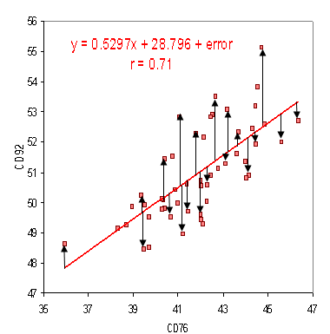
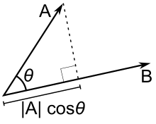
Linear Regression
prediction = dot(w.T, x)
MSE = 1/n_samples * Sum(predicted - actual)^2
Solve for unknown f(x)
J(w) = ||y - dot(w.T, x)||^2
Use derivative to find direction to change weights
dJ/dw = 2 * XTXw -2 * XTy
w = w - learning_rate * 2 * (XTXw - XTy)

Slide 46
Classification
Classification: image recognition, medical symptoms, marketing, voters ….
Features are turned into vectors and the distance between vectors is used to determine group membership. ( city block, bird's eye )
Features representing values are scaled between 0,1 or -1,1
Features representing classes are converted to one hot vectors
Outputs a one hot vector selecting a class
Classification is unsupervised learning and might not always classify in a useful way
Different runs with data that's been shuffled between runs can classify the data differently

Slide 47
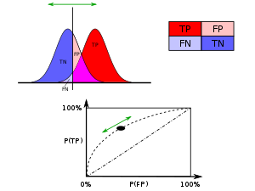
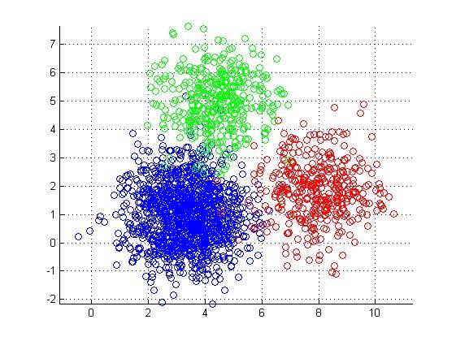
K-Means Clustering
Pick n points at random (centroids), must give algorithm the number of clusters
Put each point in the group of the closest centroid using either Manhattan or Euclidean distance, repeat until stable
results may vary on sorting order
ROC Receiver operating characteristic ~ 1
http://scikit-learn.org/stable/modules/generated/sklearn.cluster.KMeans.html
http://stanford.edu/~cpiech/cs221/handouts/kmeans.html

Slide 48
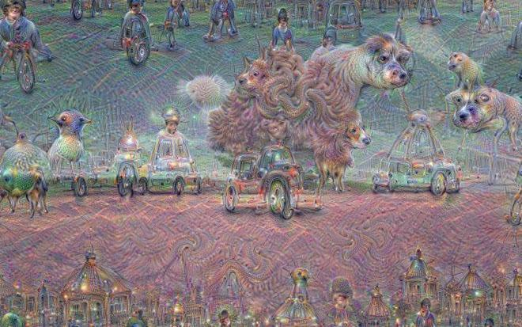
Classification with missing inputs
Joint Training of Deep Boltzmann Machines for Classification, Goodfellow (Goodfellow 2013b paper)
https://arxiv.org/pdf/1301.3568.pdf
Restricted Deep Boltzmann Machines, Salakhutdinov and Hinton
http://proceedings.mlr.press/v5/salakhutdinov09a/salakhutdinov09a.pdf
Deep Learning 4j has a nice tutorial on Boltzmann machines
https://deeplearning4j.org/restrictedboltzmannmachine
(aka Deep Belief Networks)

Slide 49
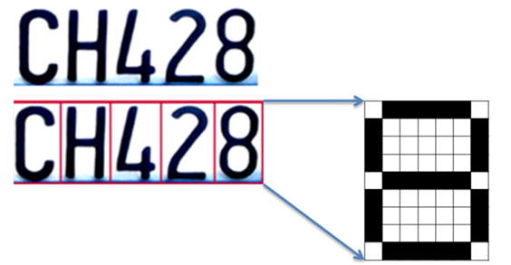
Transcription
OCR, Optical Character Recognition
Multi-digit Number Recognition from Street View
https://static.googleusercontent.com/media/research.google.com/en//pubs/archive/42241.pdf
Goodfellow talk on the paper
https://www.youtube.com/watch?v=vGPI_JvLoN0
Dataset
http://ufldl.stanford.edu/housenumbers/

Slide 50
Machine Translation
Used for natural language translation
Typically done with a recurrent network ( RNN, LSTM, GRU, ...)
One language is the input, the second language is the output.
The network is trained back and forth rather than just forward feeding data and back feeding the errors
https://nlp.stanford.edu/
https://github.com/MicrosoftTranslator/DocumentTranslator

Slide 51
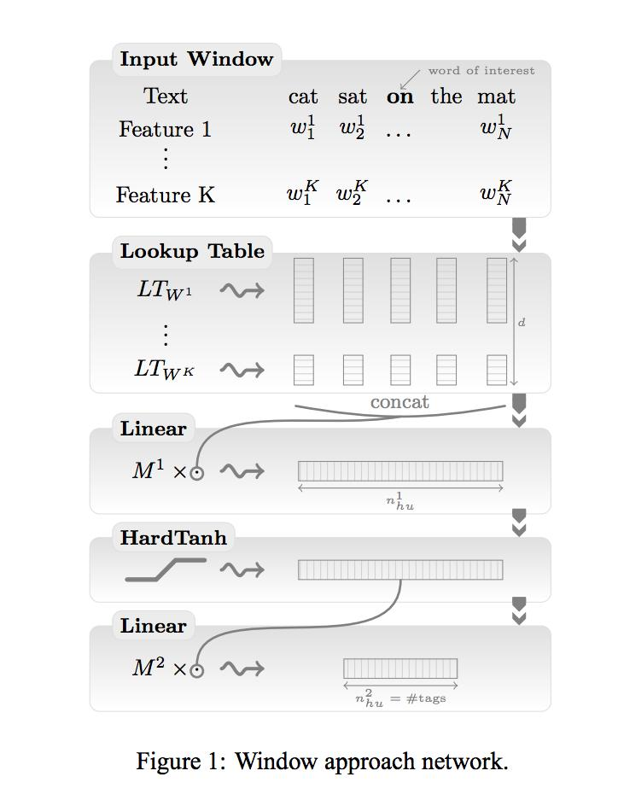
Structured Output
Collobert Home Page
https://scholar.google.com/citations?user=32w7x1cAAAAJ&hl=en
Natural Language Processing (Almost) from Scratch (Collobert 2012)
http://www.jmlr.org/papers/volume12/collobert11a/collobert11a.pdf

Slide 52
Anomaly Detection
Make a prediction, points outside the prediction area are anomalies. This is a high value research area -- many problems still to be solved ( equipment time to failure, stock market crashes, earthquake prediction…… )
RAD - Outlier Detection on Big Data
https://medium.com/netflix-techblog/rad-outlier-detection-on-big-data-d6b0494371cc
Bayesian Anomaly detection
http://www.dtic.mil/cgi-bin/GetTRDoc?AD=ADA610860

Slide 53
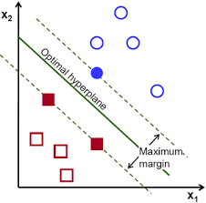
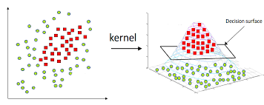
Support Vector Machines
O(n^2), can only separate 2 classes per SVM
http://scikit-learn.org/stable/modules/svm.html
https://docs.opencv.org/2.4.13.4/doc/tutorials/ml/introduction_to_svm/introduction_to_svm.html

Slide 54
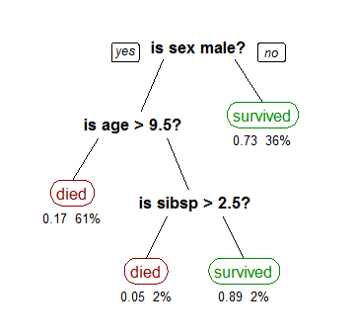
Decision Tree
Use entropy to make splits to give largest information gain
http://scikit-learn.org/stable/modules/tree.html
XGBoost
http://xgboost.readthedocs.io/en/latest/model.html
Using decision trees to see what a neural network is doing
http://citeseerx.ist.psu.edu/viewdoc/download?doi=10.1.1.12.6011&rep=rep1&type=pdf

Slide 55

Principal Components Analysis
Used to compress data to reduce features by combining them in a way that maximizes variance
Use this when data is highly correlated to create independent feature representations
https://onlinecourses.science.psu.edu/stat857/node/35
http://scikit-learn.org/stable/modules/generated/sklearn.decomposition.PCA.html

Slide 56
Manifold Learning
Find a useful way to represent the data in less dimensions
Example: represent road as 2D in a 3D world
It's like PCA but attempts to retain more information
t-SNE Used often for visualization
Doesn't always work, information can be lost or distorted
http://scikit-learn.org/stable/modules/manifold.html

Slide 57

Time Series Predictions
Used to predict future values
Must be stationary (rotate down to x axis)
Generally use a log scale
Validation data must be future data
Facebook's Prophet is a great open source tool for doing forecasts with large amounts of data
https://facebook.github.io/prophet/

Slide 58
Synthesis and Sampling
Used in the game industry to create landscapes (fractal), characters (AI), etc
https://www.gamasutra.com/topic/game-developer
Microsoft Speech recognition and synthesis
https://github.com/Microsoft/Windows-universal-samples/tree/master/Samples/SpeechRecognitionAndSynthesis
https://www.microsoft.com/en-us/research/blog/microsoft-researchers-achieve-new-conversational-speech-recognition-milestone/
https://arxiv.org/pdf/1708.06073.pdf

Slide 59
No Free Lunch Theorem
Says that if you average over all the machine learning algorithms each will have the same performance on the same data set.
The only way one strategy can outperform another is by adjusting the network to the problem.
convolutional networks for vision
recursive networks for time series
deep vs wide layers
http://www.asimovinstitute.org/neural-network-zoo/

Slide 60
Building a Machine Learning Algorithm
Cleanup data
Multiply data by weights, iterative training for non-linear data
Minimize difference between cost function and actual data
( * no free lunch theorem )
New old things being tried to adjust weights
NEAT, NeuroEvolution of Augmenting Topologies http://nn.cs.utexas.edu/downloads/papers/stanley.ec02.pdf
Genetic Algorithms https://www.doc.ic.ac.uk/~nd/surprise_96/journal/vol1/hmw/article1.html
Reinforcement Learning http://www.incompleteideas.net/book/bookdraft2018jan1.pdf

Slide 61
Videos
Bay Area Deep Learning School 2016
https://www.youtube.com/watch?v=eyovmAtoUx0 and https://www.youtube.com/watch?v=9dXiAecyJrY
Deep Learning Summer School Montreal
https://www.youtube.com/playlist?list=PL5bqIc6XopCbb-FvnHmD1neVlQKwGzQyR
http://videolectures.net/deeplearning2017_montreal/
Neural Networks for Machine Learning (Hinton Lectures 78 videos)
https://www.youtube.com/playlist?list=PLoRl3Ht4JOcdU872GhiYWf6jwrk_SNhz9

Slide 62
Blogs and things
ArXiv Papers https://arxiv.org/
Code for Arvix papers: http://www.gitxiv.com/
Uber ML Blog: https://eng.uber.com/
Deep Mind https://deepmind.com/
Netflix ML Blog: https://medium.com/@NetflixTechBlog
Aylien NLP Blog and Data: http://blog.aylien.com/research/
Open AI: https://openai.com/systems Test environments for RL learning
Kaggle: https://blog.kaggle.com/ Data, ML Blog, forums, examples, contests

Slide 63
Tensorflow
Tensorflow https://www.tensorflow.org/
Tensorflow for poets: https://codelabs.developers.google.com/codelabs/tensorflow-for-poets/#0
https://www.youtube.com/watch?v=cSKfRcEDGUs
Github: https://github.com/tensorflow/tensorflow
TensorFlow Models https://github.com/tensorflow/models
Manning MEAP Books https://www.manning.com/meap-catalog ( *these assume you know ML and don't know TF )

Slide 64
Numerical computing
Numerical Recipes in C/C++, Fortran 77/90
http://numerical.recipes/oldverswitcher.html
Introduction to Statistical Learning
http://www-bcf.usc.edu/~gareth/ISL/ISLR%20Seventh%20Printing.pdf
Elements of Statistical Learning
https://web.stanford.edu/~hastie/Papers/ESLII.pdf

Slide 65
Deep Learning
Neural Networks and Deep Learning http://neuralnetworksanddeeplearning.com/
Must Know Tricks in Deep Neural Networks http://lamda.nju.edu.cn/weixs/project/CNNTricks/CNNTricks.html
Neural Network Zoo http://www.asimovinstitute.org/neural-network-zoo/
Neural Network Playground http://playground.tensorflow.org
WildML http://www.wildml.com/

Slide 66
Software
Anaconda https://www.anaconda.com/
Microsoft CNTK https://github.com/Microsoft/CNTK
Deep Learning for Java https://deeplearning4j.org/index.html
Deep Learn JS https://deeplearnjs.org/
Keras https://keras.io/#keras-the-python-deep-learning-library
XGBoost - Extreme Gradient Boosting https://github.com/dmlc/xgboost
Data: https://archive.ics.uci.edu/ml/index.php

